Slide 1
Class 2 – 11 Sept
Conditionals
Variables
Basic input

Slide 2
Previously, in IMM120
Where is Professor Hallberg’s office?
Adjunct office: 3rd floor, right at the end of the hall.
When are Professor Hallberg’s office hours?
All day Monday from 10am until class.
What three Canvas features do you find most useful?
“First year here… so I haven’t used it much.”
“I enjoy that there’s an app”

Slide 3
Previously, in IMM120
Attendance (15%) | Less weight: 22% | Fine: 78% | More weight: 0% | 13%
Homework (25%) | Less weight: 5% | Fine: 90% | More weight: 5% | 26%
Midterm Project (25%) | Less weight: 5% | Fine: 90% | More weight: 5% | 26%
Final Project (35%) | Less weight: 5% | Fine: 90% | More weight: 5% | 35%

Slide 4
Anything else?
Questions, concerns, homework questions?

Slide 5
Debugging Tips
BUGS!! AAA!!!

Slide 6
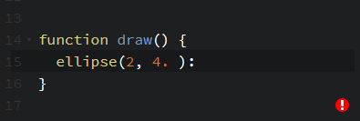
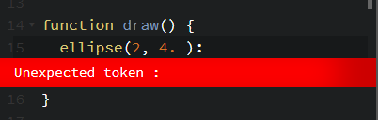
Codepen’s Helper

Slide 7
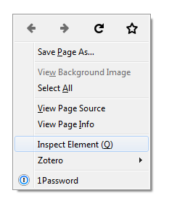
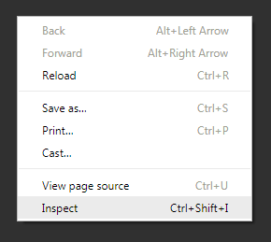
Browser Console

Slide 8
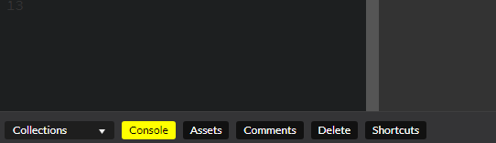
Report Data
print(something);
Make sure you use it inside of a function to avoid printing, like, onto paper.

Slide 9
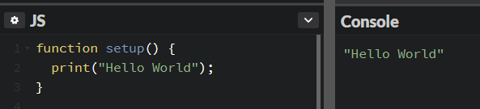
Report Data

Slide 10
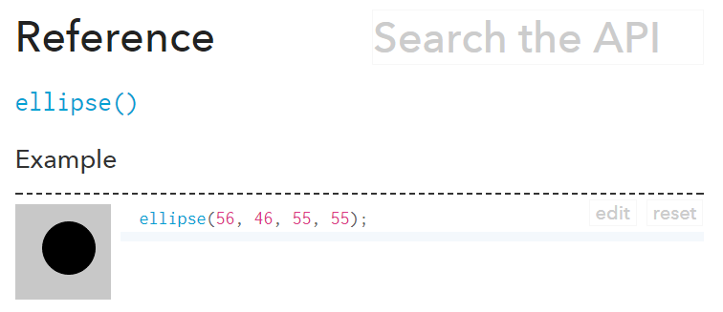
p5.js Reference
https://p5js.org/reference

Slide 11
More on Conditionals

Slide 13
Basic Input
Input events

Slide 14
Numbers that Change

Slide 15
How Does p5.js provide event information?
Boolean Variables
Event Functions
mouseIsPressed
keyIsPressed
function mousePressed() { }
function keyPressed() { }

Slide 16
Mouse Buttons

Slide 17
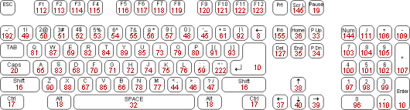
Key Codes

